Slide 1
5
INVERSE FUNCTIONS

Slide 2
5.3
The Natural Exponential Function

Slide 3
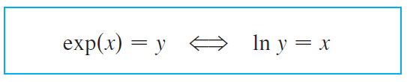



The Natural Exponential Function
Since ln is an increasing function, it is one-to-one and therefore has an inverse function, which we denote by exp.
Thus, according to the definition of an inverse function,
and the cancellation equations are

Slide 4
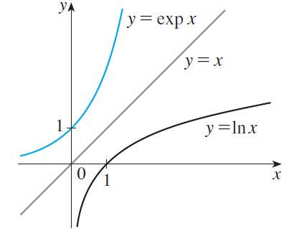
The Natural Exponential Function
In particular, we have
exp (0) = 1 since ln 1 = 0
exp (1) = e since ln e = 1
We obtain the graph of
y = ln x about the line y = x.
(See Figure 1.)
Figure 1

Slide 5

The Natural Exponential Function
The domain of exp is the range of ln, that is, ( -∞, ∞); the range of exp is the domain of ln, that is (0, ∞).
If r is any rational number, then the third law of logarithms gives
ln (e^{r}) = r ln e = r
Therefore, by , exp (r) = e^{r}
Thus exp (x) = e^{x} whenever x is a rational number.

Slide 6


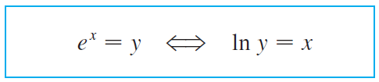

The Natural Exponential Function
This leads us to define e^{x}, even for irrational values of x, by the equation
In other words, for the reasons given, we define e^{x} to be the inverse of the function ln x. In this notation becomes

Slide 7





The Natural Exponential Function
and the cancellation equations become

Slide 8
Example 1
Find x if ln x = 5.

Slide 9

Example 1- Solution 1
From we see that
ln x = 5 means e⁵ = x
Therefore x = e⁵.

Slide 10

Example 1- Solution 2
Start with the equation
ln x = 5
and apply the exponential function to both sides of the equation:
e^{ln x} = e⁵
But says that e^{ln x} = x . Therefore, x = e⁵.

Slide 11
Example 2
Solve the equation e ^{5-3x} = 10.
SOLUTION
We take natural logarithms of both sides of the equation and use Equation 5:

Slide 12
Example 2 SOLUTION
Since the natural logarithm is found on scientific calculators, we can approximate the solution to four decimal places: x ≈ 0.8991

Slide 13
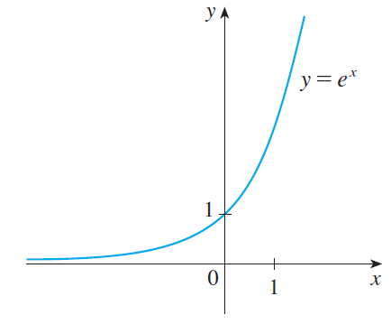
The Natural Exponential Function
The exponential function f (x) = e^{x} is one of the most frequently occurring functions in calculus and its applications, so it is important to be familiar with its graph (Figure 2) and its properties (which follow from the fact that it is the inverse of the natural logarithmic function).
The natural exponential function
Figure 2

Slide 14
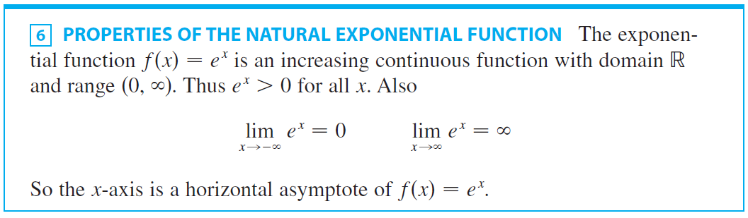
The Natural Exponential Function

Slide 15

Example 3
Find

Slide 16




Example 3 - Solution
We divide numerator and denominator by e^{2x}:

Slide 17

Example 3 - Solution
cont’d
We have used the fact that t = -2x → - ∞ as x → ∞ and so

Slide 18
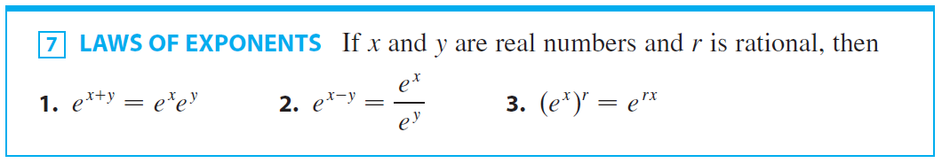
The Natural Exponential Function
F(x) = e^{x} has the properties expected of an exponential function.

Slide 19
PROOF OF LAW 1
Using the first law of logarithms and Equation 5, we have:
Since ln is a one-to-one function, it follows that: e ^{x}e ^{y} = e ^{x+y}
Laws 2 and 3 are proved similarly.
See Exercises 69 and 70.
As we will see in next section, Law 3 actually holds when r is any real number.

Slide 20
Differentiation

Slide 21
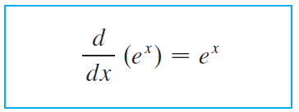

Differentiation
The natural exponential function has the remarkable property that it is its own derivative.

Slide 22
PROOF
The function y = e^{x} is differentiable because it is the inverse function of y = ln x.
We know this is differentiable with nonzero derivative.
To find its derivative, we use the inverse function method.

Slide 23
PROOF
Let y = e^{x}.
Then, ln y = x and, differentiating this latter equation implicitly with respect to x, we get:

Slide 24
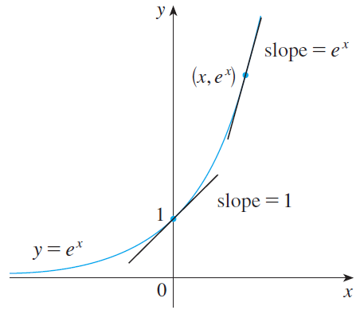
Differentiation
The geometric interpretation of Formula 8 is that the slope of a tangent line to the curve y = e^{x} at any point is equal to the y-coordinate of the point. (See Figure 3.)
This property implies that the exponential curve y = e^{x}
grows very rapidly.
Figure 3

Slide 25
Example 4
Differentiate the function y = e^{tan x} .

Slide 26



Example 4 - Solution
To use the Chain Rule, we let u = tan x. Then we have
y = e^{x}, so

Slide 27
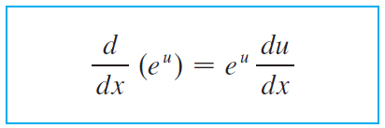

Differentiation
In general, if we combine Formula 8 with the Chain Rule as in Example 4, we get

Slide 28
Example 5
Find y ′ if y = e^{-4x} sin 5x.

Slide 29
Example 5 - Solution
Using Formula 9 and the Product Rule, we have
y ′ = e^{-4x} (cos5x)(5) + (sin 5x)e^{-4x}(-4)
= e^{-4x}(5 cos 5x – 4 sin5x)

Slide 30
Example 6
Find the absolute maximum value of the function f(x) = xe^{–x}.
SOLUTION
We differentiate to find any critical numbers: f’(x) = xe^{–x}(– 1) + e^{–x}(1) = e^{-x}(1 – x)

Slide 31
Example 6 SOLUTION
Since exponential functions are always positive, we see that f ’(x) > 0 when 1 – x > 0, that is, when x < 1.
Similarly, f ’(x) < 0 when x > 1.
By the First Derivative Test for Absolute Extreme Values, f has an absolute maximum value when x = 1.
The absolute maximum value is:

Slide 32
Integration

Slide 33
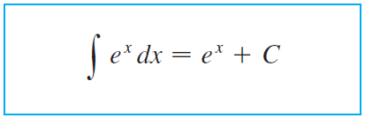

Integration
Because the exponential function y = e^{x} has a simple derivative, its integral is also simple:

Slide 34
Example 7
Evaluate
SOLUTION
We substitute u = x³.
Then, du = 3x² dx.
So, and

Slide 35
Example 8
Find the area under the curve y = e^{-3x} from 0 to 1.

Slide 36



Example 8 - Solution
The area is

